Slide 1



<NAME OF THE PROJECT>
Guess Game
GG
IBRAHIM HASSAN
Mouradi Hafsa
Python Start: Level 1
2023 – 2024
Notes:
1. INTRODUCTION

Slide 2

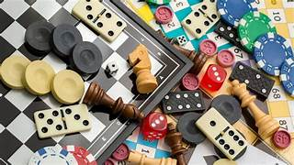
<NAME OF THE PROJECT>
IBRAHIM HASSAN
GG
Notes:
2. THE IDEA

Slide 3




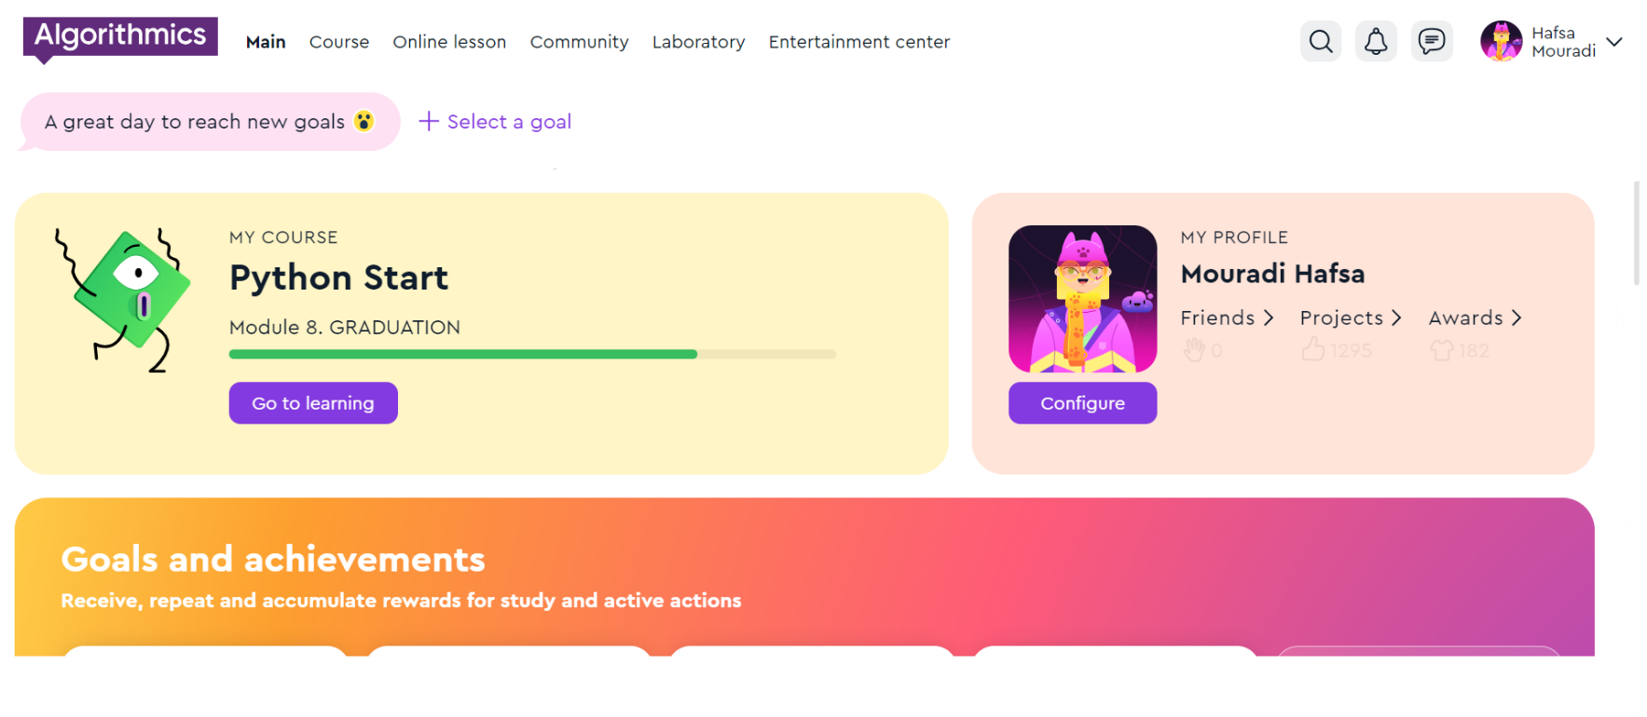
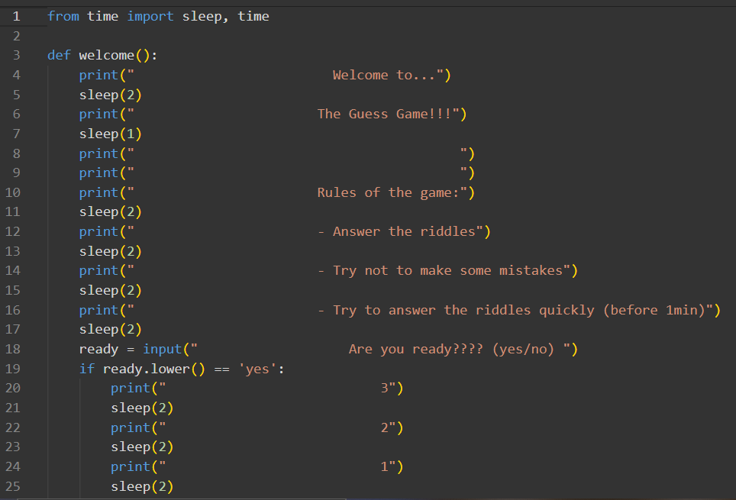
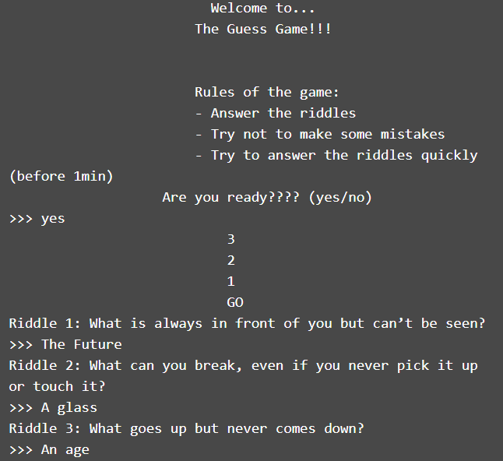

<NAME OF THE PROJECT>
Programming Language
The platform
Script
GG
Notes:
3. THE TOOLS THAT I USE

Slide 4


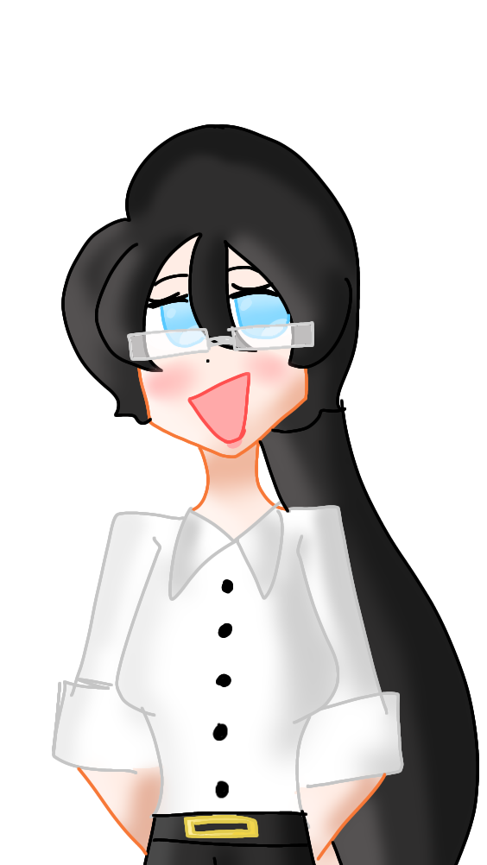
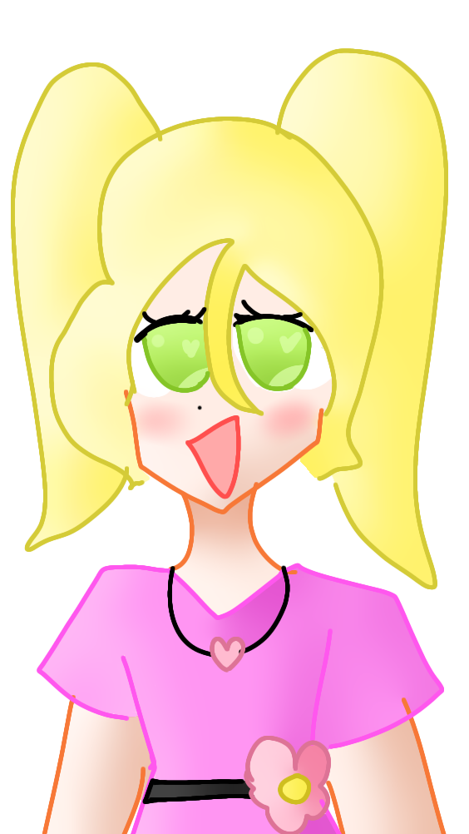
<NAME OF THE PROJECT>
USERS FEEDBACK !
Mommy installed me Guess Game and i pretty
Love it!! It’so amazing!! I became the only one ho hase an A+ in my math exam in school!!
So, what are you wating for?? Install it!!
When I was I little kid, I was playing Guess Game everyday!
And I became the most intelligent in my class and family. I’m now an engineer and i’m a programmer! So, if you want to become like me, installe Guess
Game!
IBRAHIM HASSAN
Notes:
5. CONTACT US

Slide 5
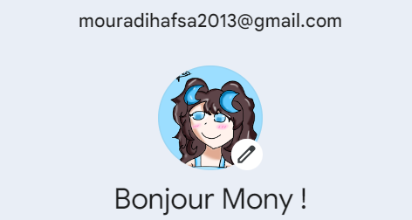
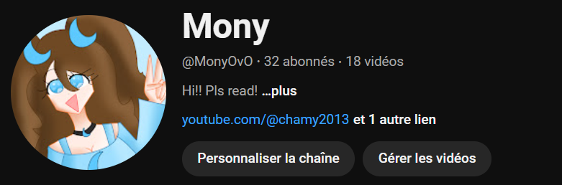
<NAME OF THE PROJECT>
If you want more information, email me in:
mouradihafsa@outlook.com
Or:
mouradihafsa2013@gmail.com
:D
And PLS subscribe to my youtube channel
IBRAHIM HASSAN
If you want to progress your Brain,
Install Guess Game !
Notes:
5. CONTACT US

